Slide 1
Exam Revision

Slide 2
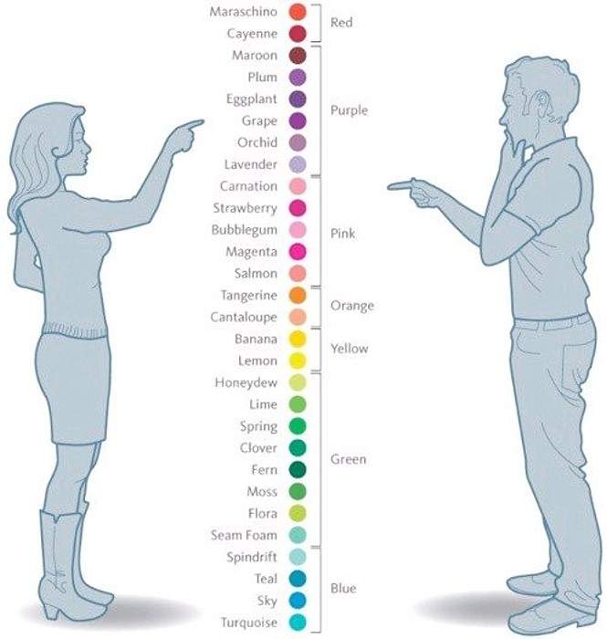
colour
Thanks Andreika

Slide 3
Exam format
No multi-choice
No short answer
7 ‘long answer’ questions
2 Robert’s
5 Beryl’s
No code writing

Slide 4
Topics
The Human
Usability testing
Visual Aesthetics
Other input/output
Sound
Haptics
Patterns and standards
Lab material
Guest lectures

Slide 5
Likely forms of questions
?
?
?
?
?

Slide 6
Finally
You (mostly) build systems for USERS – not yourself!

